Slide 1

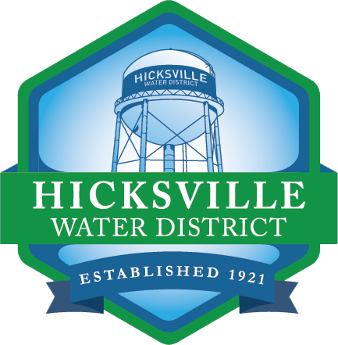
Hicksville Water District
Virtual Community Meeting
Community Update on District’s Actions to Treat Emerging Contaminants
October 28 @ 7pm & October 29 @ 1pm

Slide 2
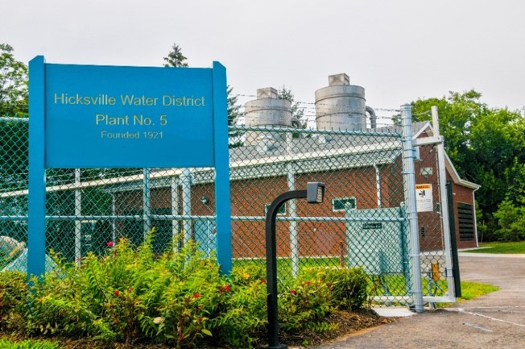
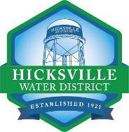
About Our District
Hicksville Water District regularly treats and delivers more than 2.5 billion gallons of water to more than 48,000 residents every year
We serve more than 15,400 homes and businesses in Hicksville, Bethpage, East Meadow, Jericho, Levittown, Syosset and Westbury in a 7.9 square-mile service territory
More than 90% of water distributed to system is used for purposes other than drinking
Infrastructure
10 Treatment Facilities
14 Wells
Two Elevated Storage Tanks
Three grounded storage tanks
More than 166 miles of water main
More than 1,600 fire hydrants

Slide 3
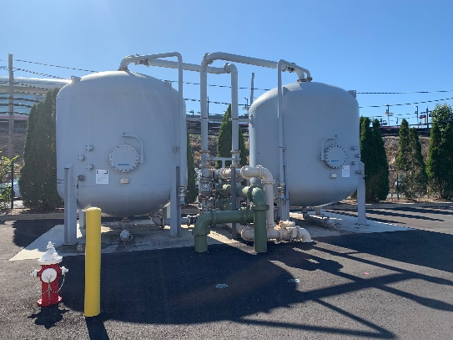
Regulations and Testing
Hicksville Water District has the responsibility to protect the local water supply in compliance with federal, state, and local regulations.
Regulations require operators of public water systems to issue annual public reports to consumers identifying the contaminants present in drinking water.
We test each of our wells for more than 170 separate parameters numerous times per year, including:
  coliform bacteria ● turbidity
  volatile organic compounds ● inorganic compounds
  lead and copper ● nitrates
  total trihalomethanes ● synthetic organic compounds
  emerging contaminants

Slide 4
How Safe is Our Water?
Waterborne Disease Rates
Life Expectancy Rates

Slide 5
How Safe is Our Water?

Slide 6
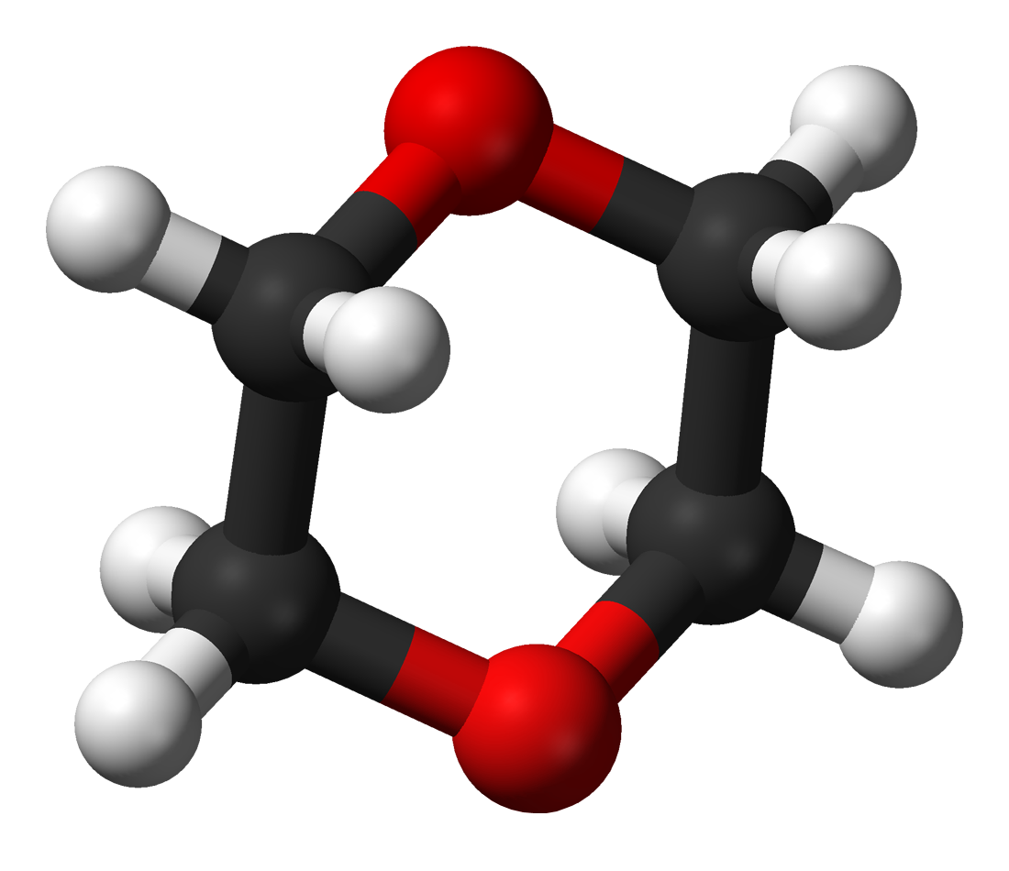
What are Emerging Contaminants?
What is 1,4-dioxane?
1,4-dioxane is a synthetic industrial chemical is miscible in water
Has been used as a stabilizer in chlorinated solvents
It is a by-product present in paint strippers, dyes, greases, antifreeze and in some consumer products like shampoos, deodorants, and cosmetics.
What are PFOA and PFOS?
PFOA and PFOS are not much of a concern for the Hicksville community at this time
Our sampling has shown that any detections are below the stringent regulations by the State (10 parts per trillion)
In the event levels increase over time, the treatment systems being constructed for 1,4-dioxane are capable of also removing these compounds

Slide 7
What is a Part Per Billion (PPB)?
Equivalent of one second in 32 years
Equivalent of one inch in 16,000 miles
What is a Part Per Trillion (PPT)?
Equivalent of one second in 32,000 years
Equivalent of one inch in 16,000,000 miles

Slide 8
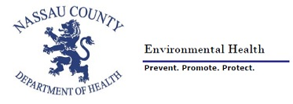
Welcome Nassau County Health Department

Slide 9
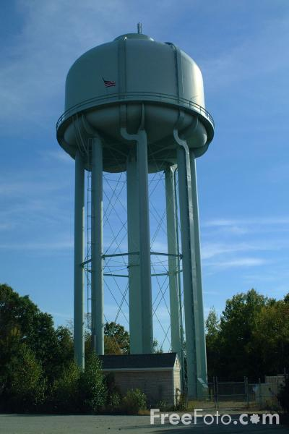
Nassau County Drinking Water and
Emerging Contaminants
William Provoncha,
Director, Office of Public Water Supply Protection & Groundwater Assessment
Nassau County Department of Health

Slide 10
Public Water Systems
46 water systems, about 400 wells, 130 storage tanks
Water Testing
Water systems-
Nassau County Department of Health-
Over 150 different contaminants monitored-
Monitoring frequencies vary-
Annual Water Quality Reports-
The Health Dept. and water systems review all monitoring results to make sure that the water is safe. The Hicksville Water District has been meeting all of their sampling requirements and providing water that is safe to drink.

Slide 11
How are New Contaminants Identified?
EPA Unregulated Contaminant Monitoring Rule (UCMR)-
Water systems over 10,000 in population,
Every 5 years.
UCMR 3- 2013-2015
30 new contaminant candidates tested. Included 1,4 Dioxane, PFOA/PFOS

Slide 12
1,4 Dioxane and PFOA/PFOS
July 2019: NYSDOH proposed new MCLs
1 ppb—1,4 Dioxane
10 ppt—PFOA/PFOS (perfluorooctanoic acid and perfluorooctanesulfonic acid )
August 26, 2020: NYSDOH implements new MCLs
New York is the first State with MCL for 1,4-dioxane.
MCLs are set at low levels well below those that have immediate health effects. They are based on increasing protection over a lifetime of exposure to make the drinking water even safer.

Slide 13
Nassau County Wells Impacted
85 wells have 1,4 Dioxane >1.0 ppb
38 wells have PFOA/PFOS >10.0 ppt
24 of the 46 water systems require immediate action to meet the new compliance deadlines.
Typical treatment methods are not effective for 1,4 Dioxane (including home filter units).
Removal of PFOA/PFOS- Carbon Filtration is effective (GAC)

Slide 14
Advanced Water Treatment
1,4 Dioxane—
Advance Oxidation Process (AOP)
PFOA/PFOS- Removed by GAC Filters
NCDH Engineers are working closely with NYSDOH officials and Nassau County water systems in a partnership to process plan reviews and approvals for construction of new treatment plants in a timely manor to come into compliance with the new regulations and provide safer drinking water.

Slide 15
ULTIMATE GOAL
Health Department staff as well as water system operators live, work and drink the water here in Nassau County. Our job is to work together towards the same goal:
Provide Safe, Clean Drinking Water

Slide 16
Compliance Deferral
New York State has allowed water providers who have taken action to treat for emerging contaminants up to two additional years to come into compliance with the new regulations
Provides an opportunity to communicate with residents about water quality while allowing the time to make the necessary infrastructure investments
Requires posting of water quality data above and beyond what is already required to our website for all to see
We are making operational adjustments to mitigate exposure while infrastructure construction occurs
Routine distribution system testing to confirm mitigation measures are effective
The two-year deferral has the potential for a one-year extension based on a demonstrated need – we do not anticipate needing the extension at this time

Slide 17
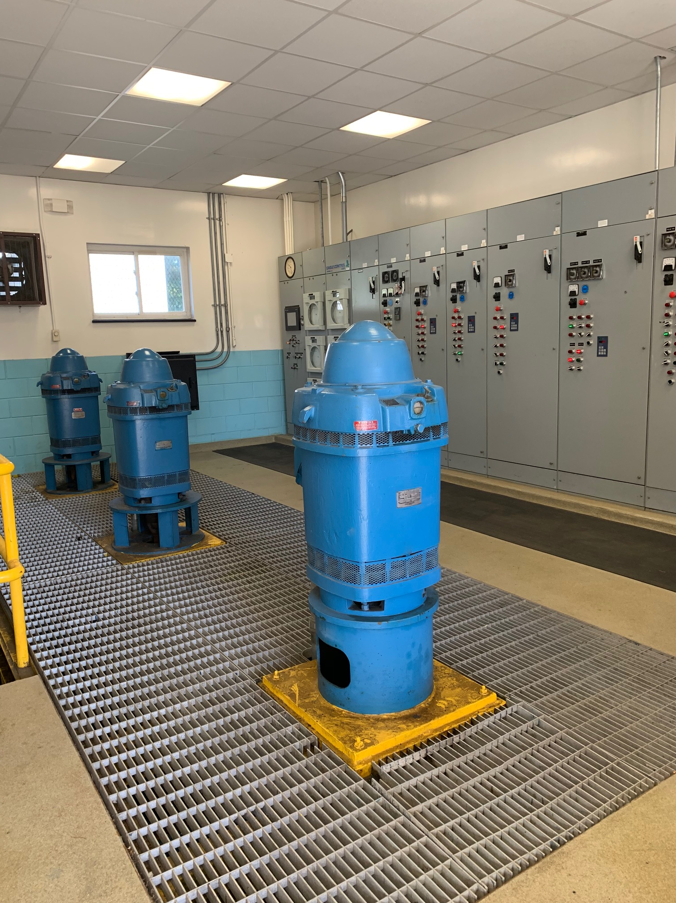
History of 1,4-Dioxane at HWD
1,4-Dioxane has been detected in more than 70% of drinking water supply wells across Long Island
Sampling for 1,4-dioxane began in 2013 as a part of the EPA Unregulated Contaminant Monitoring Rule 3 (UCMR3)
  In Hicksville, the compound was detected at 6 of the 8 entry point samples, ranging in concentration from 0.4 ppb to 34.0 ppb
The highest concentration of 34.0 ppb was recorded at the District’s Well No. 4-2. As a result, the District immediately removed Well 4-2 from service in 2016 when results from UCMR testing were returned
  The District did not use this well for the community supply since it was alerted of the results from the UCMR3

Slide 18
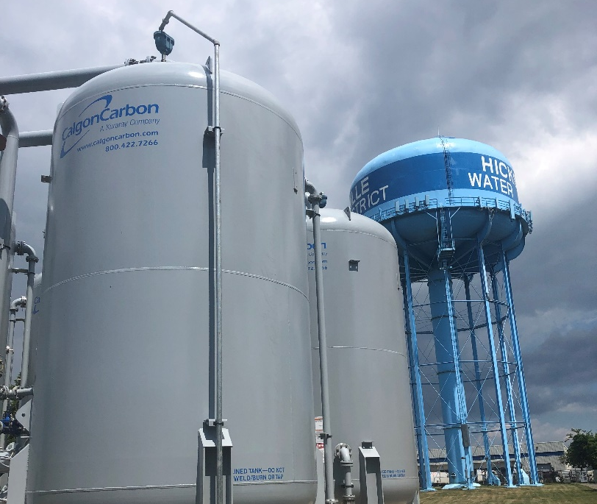
1,4-Dioxane Update
Our mission each and every day is to provide the residents of Hicksville with the highest quality water possible. In 2018, we started our deep dive into the process for implementing treatment for the removal of these emerging contaminants. So much progress has been made since and construction of additional treatment facilities at three more of our plant sites is nearing completion.
Local Impact:
10 wells exceeding new regulation of 1 ppb
4 wells have levels below new regulation
  2 of these wells have levels above what Nassau County determines to be an actionable level (>0.5 ppb)

Slide 19
1,4-Dioxane Timeline 2019-2020
July 2019 - Pilot testing protocol for Plant No. 1 submitted to state and county health departments
August 2019 - Pilot testing conducted at Plant No. 1
October 2019 - Board of Commissioners pass an emergency resolution that authorizes our engineering team to design full-scale AOP treatment systems and empowers the District to directly engage equipment vendors and contractors for construction
November 2019 - Pilot testing report for Plant No. 1 submitted to state and county health departments
December 2019 - Pilot testing protocol for Plant No. 4 submitted to state and county health departments; Pilot testing conducted at Plant No. 4

Slide 20
1,4-Dioxane Timeline 2019-2020 (continued)
January 2020 - Pilot test report for Plant No. 4 submitted to state and county health departments; Construction mobilization begins at Plant Nos. 1 & 4
February 2020- Engineering plans and specifications for Plant No.1 submitted to state and county health departments
March 2020- Engineering plans and specifications for Plant No. 1 submitted to state and county health departments
April 2020- Engineering report, plans, and specifications for Plant No. 4 submitted to state and county health departments
June 2020- Pilot test report for Plant No. 4 accepted by county health department; County health department beginning review of engineering report
Amidst the pandemic, the Hicksville Water District has continued to work diligently to outfit all our water treatment facilities with the most up-to-date filtration systems. The District’s construction is well underway and we are on track to have the facilities built before the anticipated compliance timeline.

Slide 21
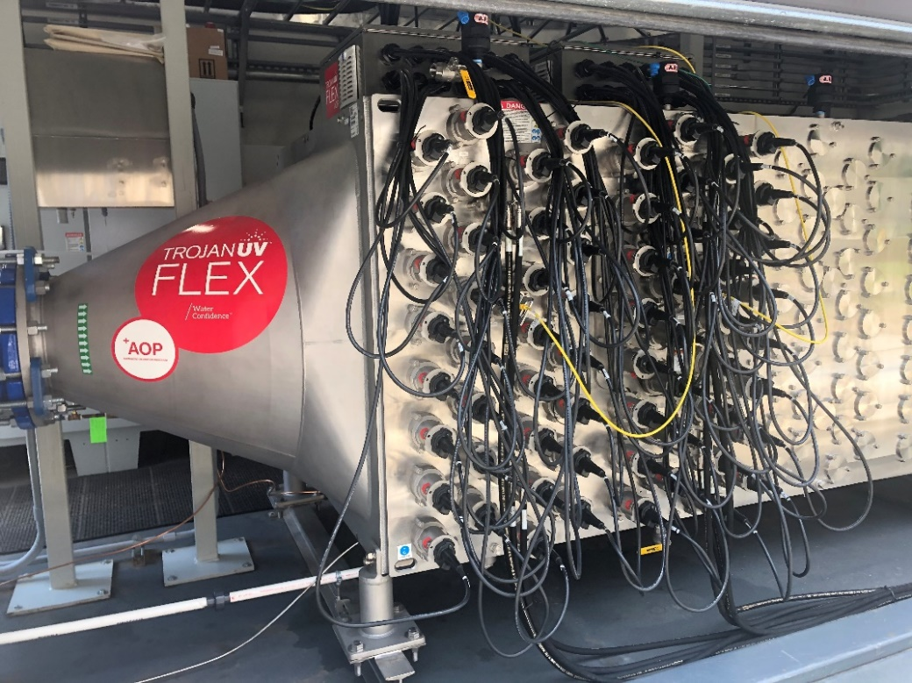
Good News! 1,4-Dioxane Treatment is up and running!
The Hicksville Water District is proud to announce that AOP systems at Plants 1 & 4 are officially online!
Among one of the first water providers on Long Island to have this treatment system online
Rids water supply of 1,4-dioxane
  Also removes PFOA and PFOS
Complies with new State regulations

Slide 22
Interim Treatment Measures
Passed emergency resolutions allowing the District to move swiftly in preordering the necessary treatment equipment
Completed all preliminary and planning work, including the required pilot studies to ensure the advanced treatment technology works as needed at each impacted well site
Implementing interim wellhead treatment at Plants 5 & 9
  Plan to have systems online in Summer 2021
Constructing permanent treatment at Plant 8
  Plan to have this system online in 2022

Slide 23
More About the Treatment
Advanced Oxidation Process (AOP)
  Only approved treatment method for removing 1,4-dioxane
  Uses ultraviolet light reaction and a low concentration of hydrogen peroxide to destroy 1,4-dioxane molecules
Granular Activated Carbon (GAC)
  Industrial-sized carbon filters
  Removes any remaining hydrogen peroxide and other volatile organic compounds (VOC)
In summary, water is pumped from the ground, moves through the AOP treatment, then GAC treatment, followed by pH adjustment, then chlorinated, tested, and put into distribution for consumption.

Slide 24
1,4-Dioxane Treatment Costs
Capital Costs
Estimated capital costs Districtwide: $70 million
  Treatment systems to be installed at 11 out of 14 well sites
Annual Costs
Bonding capital costs at 4% for 20 years: $4.8 million annually
Operation and maintenance costs: ≈ $1.8 million annually
Total costs incurred annually: ≈ $6.6 million
Current budget: $ 12.2 million

Slide 25
Funding These Treatment Projects
With capital costs expected to top $70 million, the District is pursuing every funding avenue to remove the financial burden from Hicksville residents.
Grant Funding
  More than $17 million in grants awarded from the state
  Grants are awarded on a project-by-project basis and only cover 60% of the project cost
  Given the state’s financial situation, it is unclear if future grants will be awarded
Bonding
  Strong reporting by Moody's Rating Agency allows District to borrow money at a very low cost
  Seeking authorization for a $50 million bond to complete the necessary capital projects
Litigation Against Polluters
  Aggressively pursuing damages against polluters
  Litigation is expected to take years, but if successful, the compensation will fund capital improvements and pay down bonded debt

Slide 26
Financials - A Need to Raise Rates
The Hicksville Water District has received more than $17 million in grants to help fund the necessary infrastructure at Plants 1 and 4 which covers 72% of the projected cost ($23.4 million) for Plants 1, 4 and 8.
Nine more plants are slated to receive AOP treatments
A modest rate increase is necessary to cover the costs for these new treatment systems (amounts to an average increase of $6 per quarter)
This year, we have been able to avoid the need to raise taxes
2020 Water Rates
2021 Water Rates
Consumption (gallons) | Charges
Up to 10,000 | $9.00 minimum
11,000 to 26,000 | $1.00/thousand gallons
27,000 to 46,000 | $1.25/thousand gallons
47,000 to 66,000 | $1.75/thousand gallons
Over 67,000 | $2.35/thousand gallons
Consumption (gallons) | Charges
Up to 10,000 | $12.00 minimum
11,000 to 26,000 | $1.30/thousand gallons
27,000 to 46,000 | $1.70/thousand gallons
47,000 to 66,000 | $2.40/thousand gallons
Over 67,000 | $3.20/thousand gallons

Slide 27
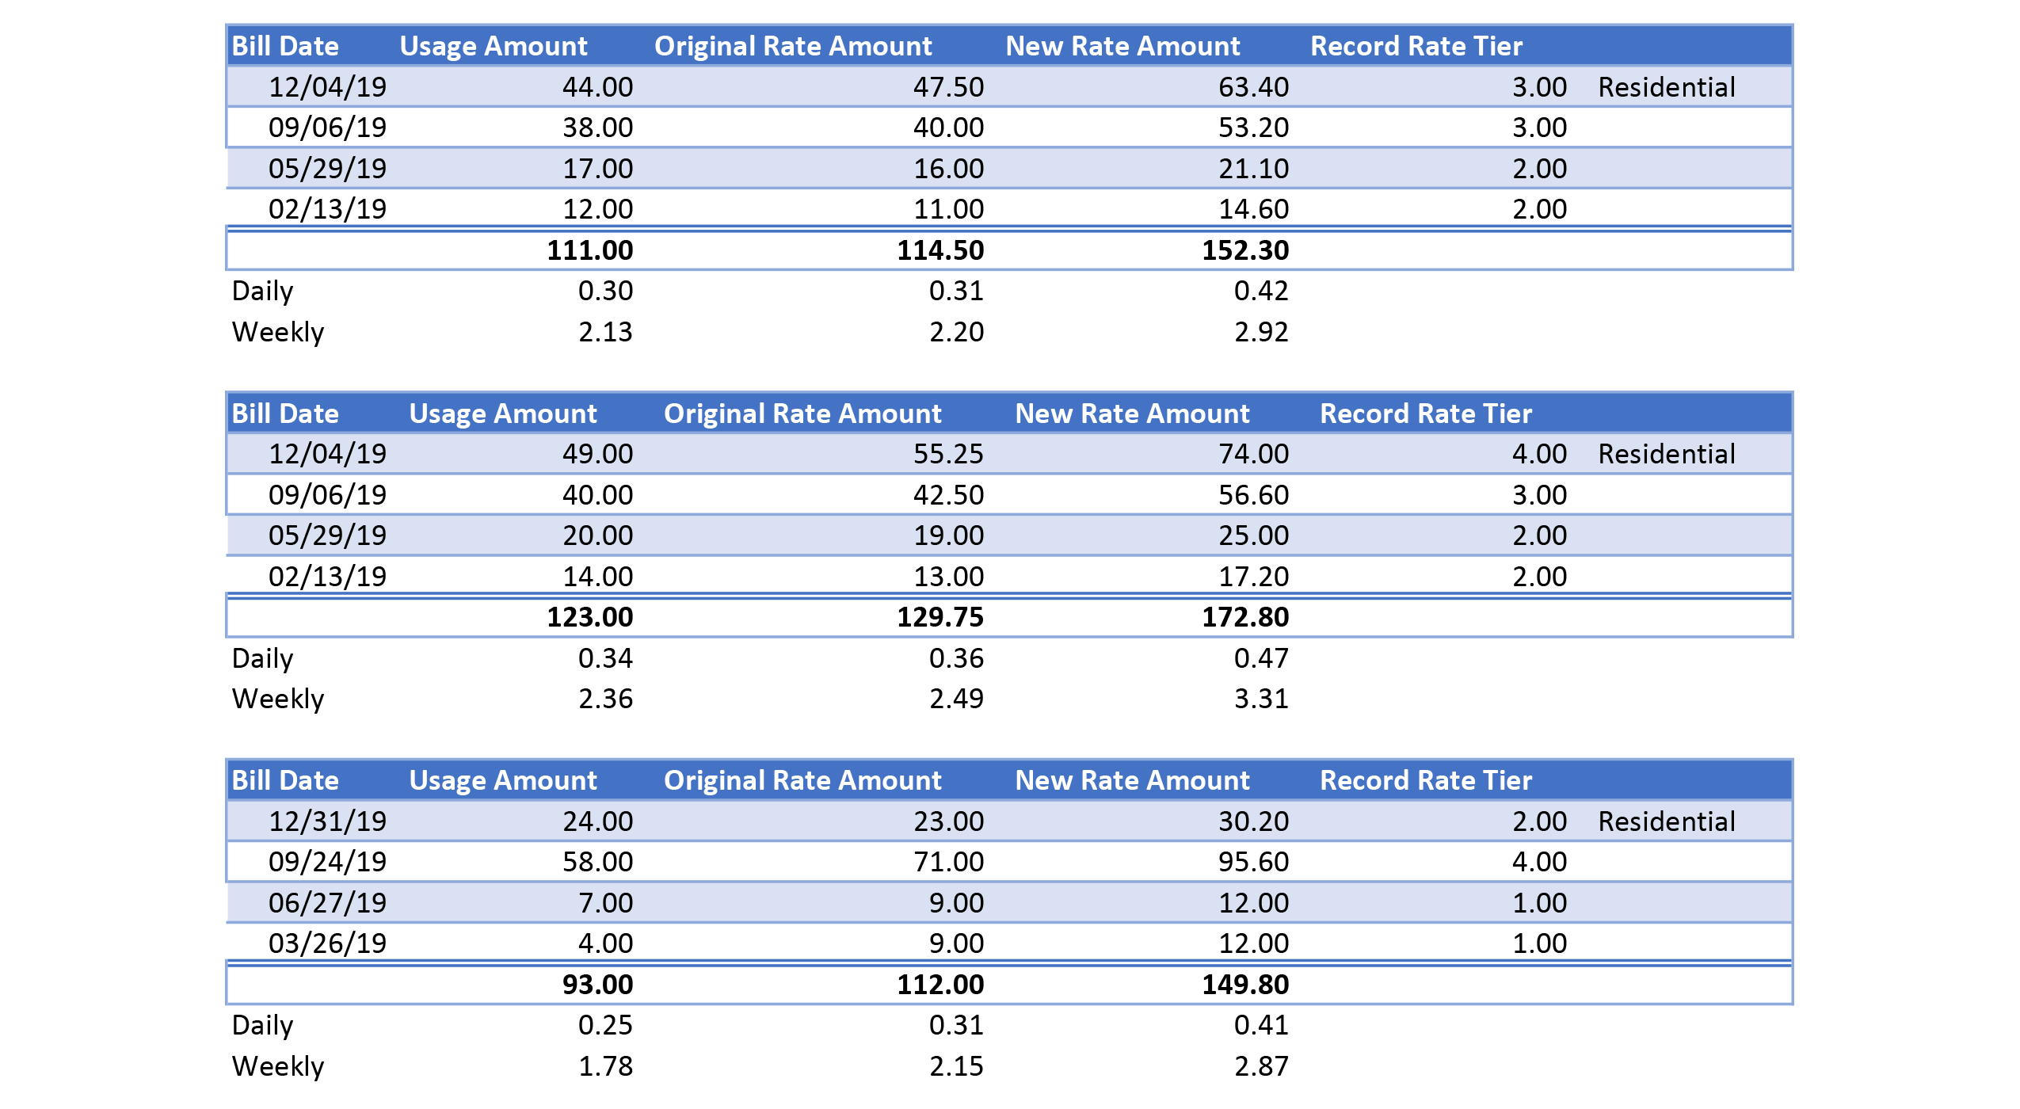
What will rates look like? Residential
(Examples)

Slide 28
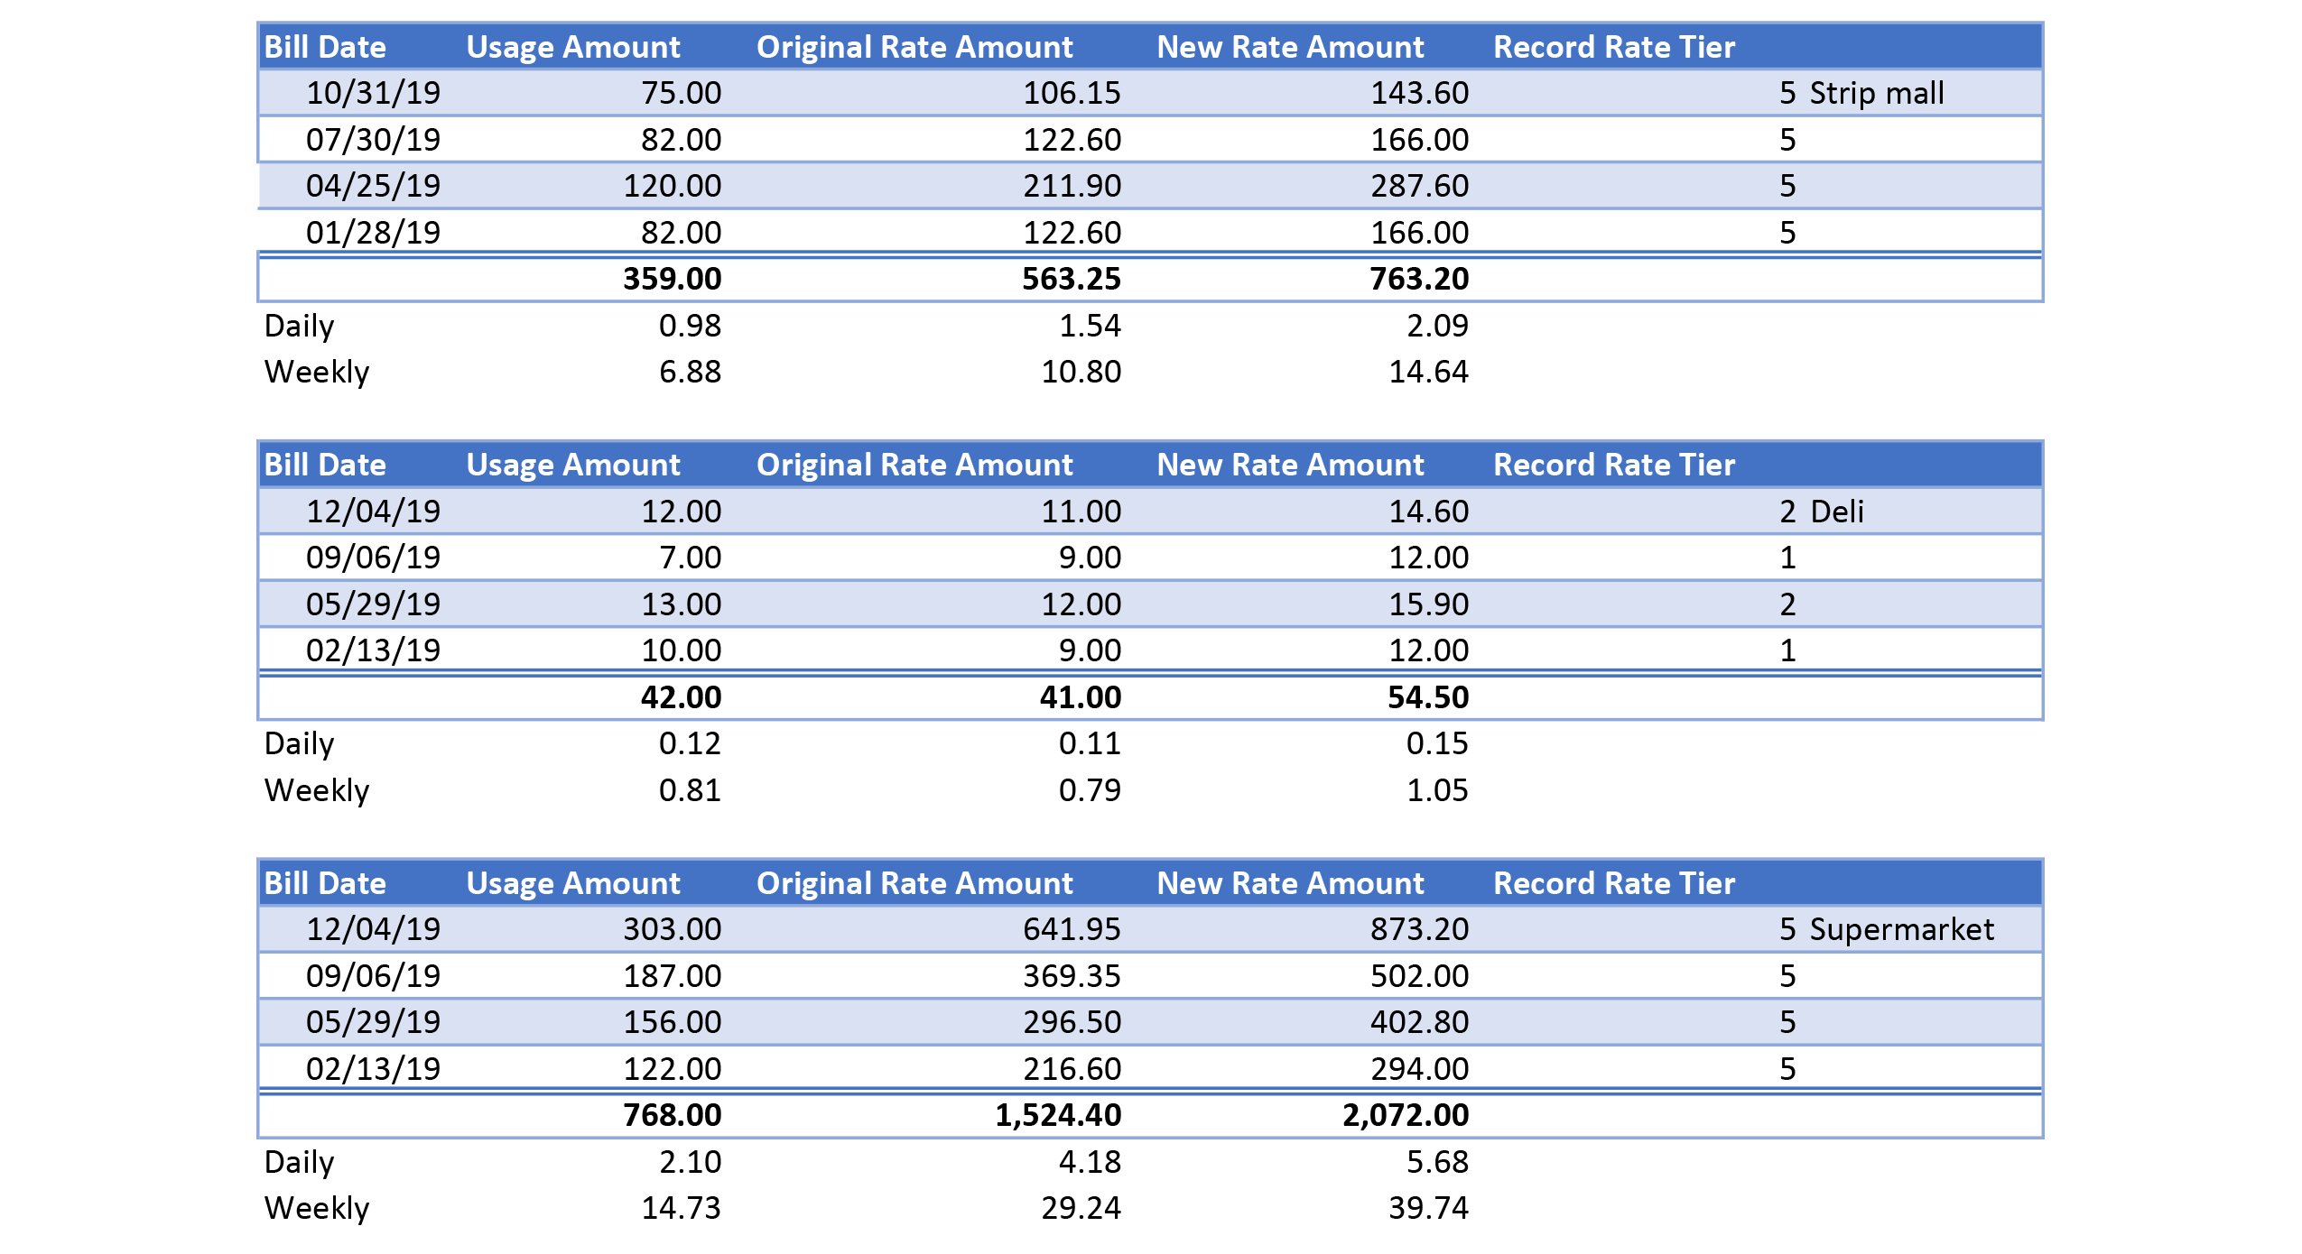
What will rates look like? Commercial
(Examples)

Slide 29
Comparison to Other Utilities
Rank | Utility | Average Monthy Cost
1 | Water - Hicksville WD | $37
2 | Cell phone | $80
3 | Heat (Oil/Gas) | $190
4 | Internet-TV | $220
5 | Electric | $240

Slide 30
Conclusion
The New York State Health Department has come out with new regulations on emerging contaminants, and the Hicksville Water District is responding as quickly as possible
Keeping the public water supply safe is our primary concern
New advanced oxidation process (AOP) treatment systems are being installed on 11 out of 14 wells by the compliance date
HWD is implementing a modest rate increase instead of raising taxes to combat increasing costs
We need assistance from elected officials on behalf of our residents to ensure water rates do not increase further

Slide 31
Thank You for Attending!
We look forward to answering your questions!
Feel free to contact the District at any time!
info@hicksvillewater.org (516) 931-0184

